Slide 1
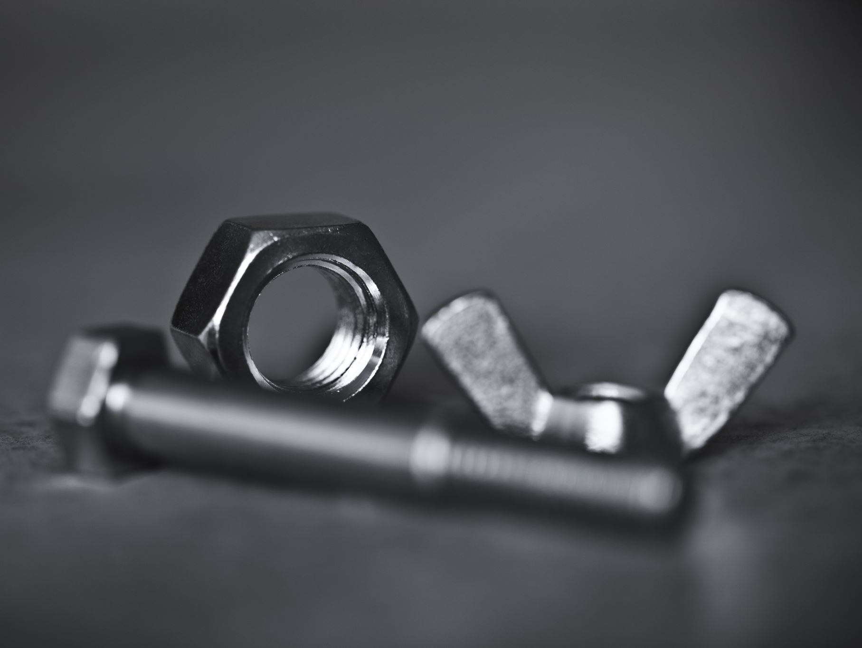
Hardware
IGCSE Computer Science (0478) – Chapter 3 Detailed Presentation

Slide 2
Chapter Overview
Input Devices
Output Devices
Storage Devices (Primary, Secondary, Offline)
Von Neumann Architecture

Slide 3
What Are Input Devices?
Hardware that sends data to a computer for processing.
Manual (human‑operated) and automatic (sensor‑based) devices.

Slide 4
Manual Input Devices
Keyboard – text entry, command shortcuts
Mouse / Touchpad – pointer control and selection
Touchscreen – direct finger/stylus input
Graphics Tablet – precision drawing for designers
Game Controller / Joystick – gaming and simulations

Slide 5
Automatic Input Devices
Scanner – digitises images or documents
Barcode & QR Scanner – retail, inventory
OCR / OMR / MICR – reading printed text/marks/cheques
Digital Camera & Webcam – photo, video
Microphone – voice commands, VoIP
Sensors (temperature, motion, light) – IoT & robotics

Slide 6
What Are Output Devices?
Hardware that receives data from a computer and presents it to users.

Slide 7
Visual Output
Monitor / Display (LCD, LED, OLED) – graphical interface
Projector – large‑scale presentations
VR / AR Headset – immersive environments

Slide 8
Printed Output
Inkjet Printer – affordable colour photos
Laser Printer – fast, high‑volume text
3D Printer – additive manufacturing of prototypes

Slide 9
Audio & Haptic Output
Speakers & Headphones – music, alerts
Actuators – motors controlling robots, drones
Haptic Devices – vibration feedback in gaming controllers

Slide 10
Storage Categories
Primary Storage – directly accessible by CPU (RAM, ROM)
Secondary Storage – internal mass storage (HDD, SSD)
Offline / Removable – optical discs, USB flash, external drives

Slide 11
Primary Storage
RAM (Random Access Memory): volatile, temporary workspace
• DRAM for main memory, SRAM for CPU cache
ROM (Read‑Only Memory): non‑volatile, stores firmware/boot code

Slide 12
Magnetic Storage – HDD
Platters coated with magnetic material spin at 5 400–15 000 RPM
Read/Write heads hover nanometres above platters
Data stored in tracks and sectors as magnetic polarity
Pros: multi‑TB capacity, low cost per GB
Cons: mechanical wear, shock‑sensitive, slower than SSD

Slide 13
How an HDD Works
1. Platters spin inside sealed enclosure
2. Actuator positions the head over desired track
3. Head magnetises tiny domains (write) or senses polarity (read)
4. Controller translates magnetic changes into binary data

Slide 14
Solid‑State Storage – SSD / Flash
Uses NAND flash memory with no moving parts
Data stored as charge in floating‑gate transistors
Fast access (SATA ~550 MB/s, NVMe >3 GB/s)
Silent, shock‑resistant, lower latency, higher cost per GB

Slide 15
How an SSD Works
1. Data written as electrons trapped in floating gate (0/1)
2. Pages grouped into blocks; whole blocks erased before rewrite
3. Controller manages wear‑levelling & error correction
4. TRIM command cleans unused blocks to maintain speed

Slide 16
Optical Storage – CD / DVD / Blu‑ray
Data encoded as pits and lands on disc surface
Laser reflects differently from pits vs lands (binary)
Capacities: CD 700 MB, DVD 4.7 GB, Blu‑ray 25 GB
Cheap distribution, good archival life, slower and fragile

Slide 17
How Optical Discs Work
1. Disc spins while laser focuses on spiral track
2. Reflected light intensity changes at pits
3. Sensor converts reflections into digital data for CPU

Slide 18
Storage Comparison Highlights
Speed: SSD > HDD >> Optical
Capacity: HDD (multi‑TB) > SSD > Optical
Cost per GB: HDD cheapest, SSD moderate, Optical highest
Durability: SSD robust, HDD mechanical, Optical scratch‑sensitive

Slide 19
Von Neumann Architecture
Stored‑program computer model used by most CPUs
Components: CPU (ALU + Control Unit), Memory, Input/Output, Buses
Buses: Address, Data, Control – carry signals between components

Slide 20
Fetch–Decode–Execute Cycle
1. Fetch: PC address placed on Address Bus to memory; instruction loaded to MDR
2. Decode: Control Unit interprets opcode
3. Execute: ALU or relevant unit performs operation; results stored
Registers: PC, MAR, MDR, ACC, CIR

Slide 21
Key Takeaways
Wide range of input & output devices enable human‑computer interaction
Storage choice balances speed, capacity, cost, durability
Von Neumann architecture underpins modern computing
Understanding hardware is essential for selecting and troubleshooting systems

