Slide 1
Compression Techniques
IGCSE Computer Science - Detailed Explanation

Slide 2
What is Compression?
Compression is the process of reducing the size of a file while preserving its contents.
It helps save storage space and reduce transmission time over the internet.
There are two main types of compression: Lossless and Lossy.

Slide 3
Lossless Compression
Lossless compression reduces file size without losing any data.
The original file can be perfectly reconstructed from the compressed file.
Examples: ZIP files, PNG images, FLAC audio.

Slide 4
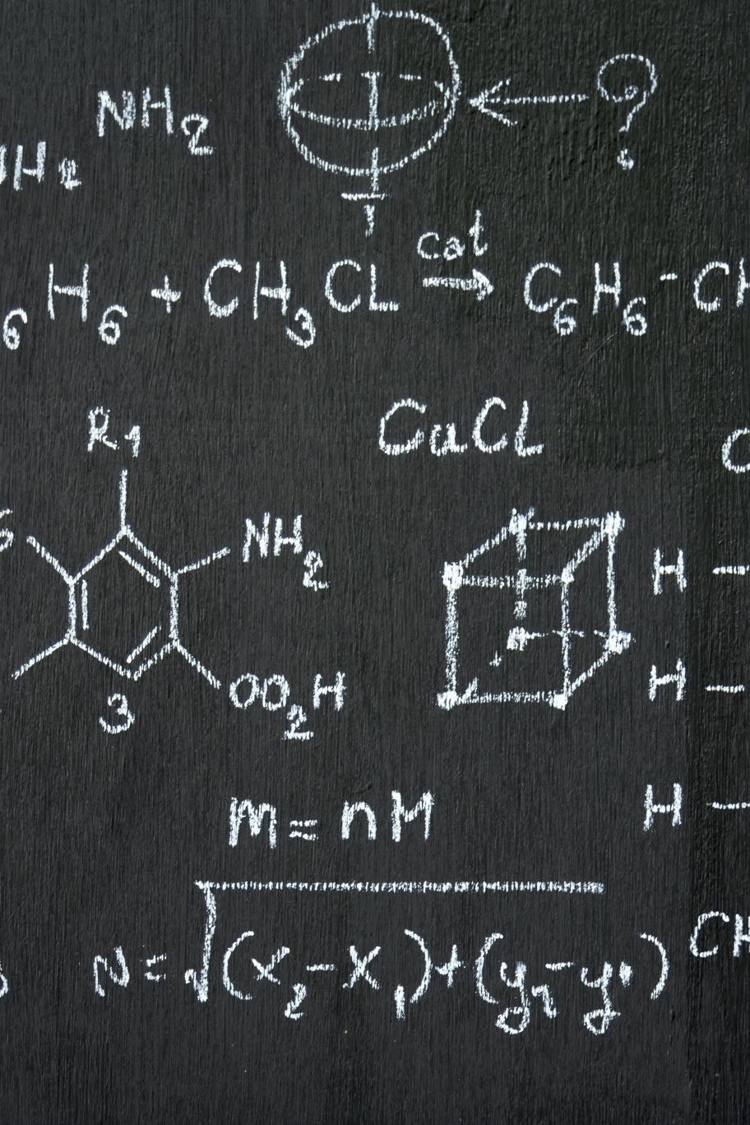
Lossless Techniques
1. Run-Length Encoding (RLE):
- Compresses data by reducing repeated characters.
- Example: AAAABBBCC → 4A3B2C
2. Huffman Coding:
- Uses frequency of characters to build a binary tree.
- More frequent characters get shorter codes.
- Example: E(15), T(12), A(9) → assign shorter binary codes to E and T.

Slide 5
Lossy Compression
Lossy compression removes some data to achieve higher compression.
The original file cannot be perfectly reconstructed.
Used for media files where exact reproduction isn’t necessary.
Examples: JPEG images, MP3 audio, MP4 video.

Slide 6
Lossy Techniques
1. JPEG (Image):
- Removes details the human eye won’t notice.
- Reduces color precision and detail in complex areas.
2. MP3 (Audio):
- Removes frequencies outside human hearing range.
- Reduces precision of sound samples.
3. MP4 (Video):
- Combines image and audio compression.
- Drops similar frames or background details.

Slide 7
File Size Calculation: Images
Bitmap Image File Size = Width × Height × Colour Depth (bits)
Example: 1920 x 1080 image with 24-bit color
File Size = 1920 × 1080 × 24 = 49,766,400 bits ≈ 5.96 MB

Slide 8
File Size Calculation: Audio
Audio File Size = Sample Rate × Bit Depth × Channels × Duration
Example: 44,100 Hz, 16-bit, Stereo (2 channels), 60 seconds
File Size = 44100 × 16 × 2 × 60 = 84,672,000 bits ≈ 10.58 MB

Slide 9
Bitmap Images
Bitmap (Raster) images are made up of pixels.
Each pixel stores color information.
Quality reduces when resized (pixelation).
Examples: JPEG, PNG, BMP

Slide 10
Vector Images
Vector images are made using mathematical shapes (lines, curves).
Do not lose quality when scaled.
Smaller file sizes for simple graphics.
Examples: SVG, EPS, PDF (vector parts)

Slide 11
Bitmap vs Vector: Comparison
Bitmap: Detailed photos, pixel-based, large files, loses quality on zoom.
Vector: Logos/Icons, resolution independent, small files, not suited for photos.

Slide 12
Summary
Compression reduces file size for storage and transmission.
Lossless: no data lost; perfect restoration.
Lossy: data lost; used for media.
Know how to calculate file sizes.
Understand differences between vector and bitmap images.

